Slide 1
Web Development 3
Introduction to PHP Part 2
Ashley Cahill
ashley.cahill@tus.ie

Slide 2

Moodle
https://moodle.midlands.tus.ie/course/view.php?id=13541

Slide 3
Recap
Code files have .PHP extension
PHP variables must begin with $
Variables are case-sensitive
HTML can be embedded into a PHP file
Examples
Echo
Variables

Slide 4
Forms
Forms can be created in HTML with PHP used to add functionality.
Get and Post methods are the HTTP request methods used inside the <form> tag to send form data to the server.
Get is the default.

Slide 5
Form (GET)
GET requests include all required data in the URL.
Can be bookmarked
GET requests are re-executed but may not be re-submitted to server if the HTML is stored in the browser cache.
GET is less secure because data sent is part of the URL
PHP $_GET is a PHP super global variable which is used to collect form data after submitting an HTML form with method="get".

Slide 6
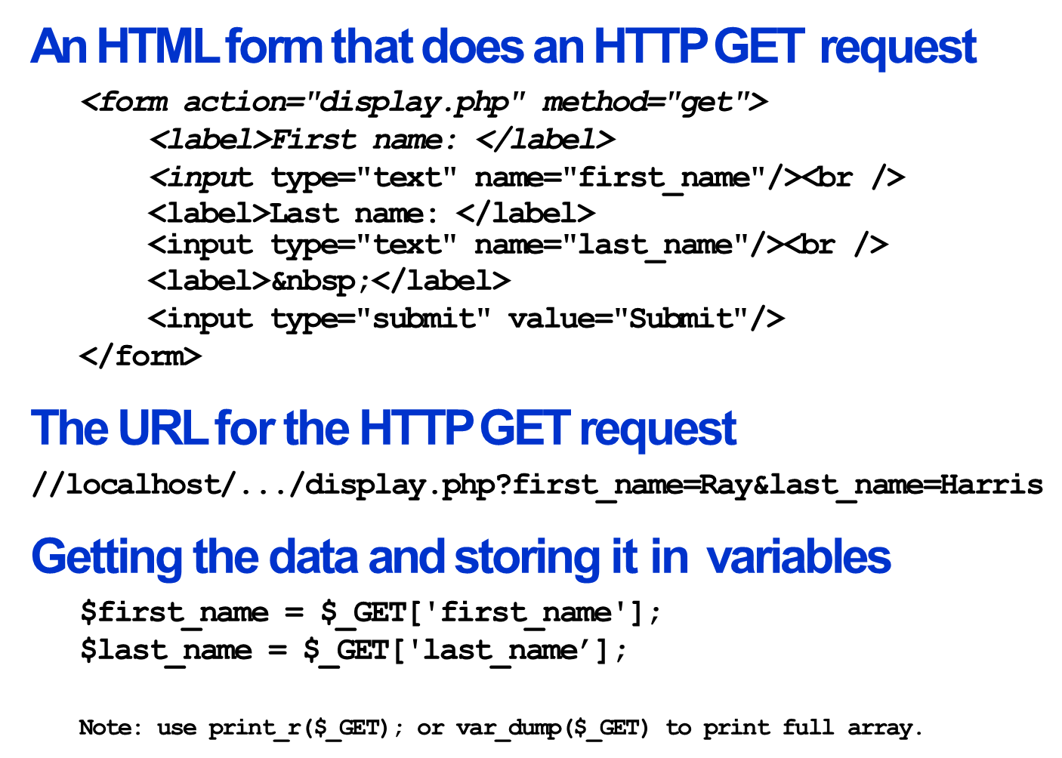
Form (GET)

Slide 7
Form (POST)
HTTP POST requests supply additional data from the client (browser) to the server in the message body.
Can not be bookmarked.
User is alerted that data will need to be re-submitted.
POST is a little safer than GET because the parameters are not stored in browser history or in web server logs.
PHP $_POST is a PHP super global variable which is used to collect form data after submitting an HTML form with method=“post".

Slide 8
Form (POST)
An HTML form that specifies the POST method
<form action="display.php" method="post">
Code that gets the data from the $_POST array
$first_name = $_POST['first_name'];
$last_name = $_POST['last_name'];

Slide 9
Lab Work
Forms
GET
POST
Remember
HTML Forms allow users to submit data
GET and POST are methods for submitting/sending data
Action tag indicates where to go on submission
Method tag indicates if Get or Post
$_GET and $_POST used to collect submitted form data

Slide 10
Forms
<form action="display-get.php" method="get">
<!– HTML Code -->
<input type="submit" value="Submit"/>
</form>

Slide 11
Recap
Forms can be used to send data/variables to php code in another page. (Form can be created in a HTML page, data sent to php page.)
GET and POST methods are used to send data
In Form code… <form action “display.php” … specifies the file you want to send the data to.
<form action “display.php” method “post”> specifies the method to used to send the data.

Slide 12
Arithmetic Operations
Common arithmetic operators
Operator Example Result
+ 5 + 7 12 - 5 – 12 -7 * 6 * 7 42 / 13 / 4 3.25 % 13 % 4 1 ++ $counter++ adds 1 to counter variable -- $counter-- subtracts 1 from counter variable

Slide 13
Arithmetic Operations Examples
Some simple numeric expressions
$x = 14;
$y = 8;
$result = $x + $y; //22
$result = $x - $y; //6
$result = $x * $y; //112
$result = $x / $y; //1.75
$result = $x % $y; //6
$x++; //15
$y--; //7

Slide 14
Arithmetic Operations Examples
Statements that calculate a discount
$list_price = 19.95;
$discount_percent = 20;
$discount_amount = $list_price * $discount_percent * .01;
$discount_price = $list_price - $discount_amount;

Slide 15
Arithmetic Operations Precedence
Order of precedence
Order Operators Direction
1 ++ Left to right
2 -- Left to right
3 * , / , % Left to right
4 + , - Left to right
Order of precedence and the use of parentheses
3 + 4 * 5 //23
(3 + 4) * 5 //35

Slide 16
Compound Assignment
The compound assignment operators
.=
+=
-=
*=
/=
%=

Slide 17
Compound Assignment – String Data
Standard assignment operator
$name = ‘Ray ‘; $name = $name . ‘Harris’; //’Ray Harris’
Compound assignment operator
$name = ‘Ray ‘; $name .= ‘Harris’; //’Ray Harris’

Slide 18
Compound Assignment –Incrementing
Standard assignment operator
$count = 1; $count = $count + 1;
Compound assignment operator
$count = 1; $count += 1;
Increment operator
$count = 1; $count++;

Slide 19
Compound Assignment –Incrementing
Appending numeric data to a string value
$message = ‘Months: ‘; $months = 120;
$message .= $months; //’Months: 120’
How to work with numeric data
$subtotal = 24.50; $subtotal += 75.50; //100
$subtotal *= .9; //90 → (100 * .9)

Slide 20
Lab Work
Arithmetic Operations
Create a file named “arithmetic operations.php”
Add php code to the top of the page to create variables, assign values and carry out arithmetic operations.
Write HTML code underneath to display the results.

Slide 21
Relational and Logical Operators
Relational Operators
Operator Example == $last_name == “Harris” , $test+score == 10
!= $first_name != “Ray” , $months != 0
< $age < 18
<= $investment <=0 > $test_score > 100
>= $rate / 100 >= 0.1

Slide 22
Logical Operators - Order of Precedence
Logical Operators
Operator Example ! !is_numeric($age)
&& $age > 17 && $score < 70
|| !is_numeric($rate) || $rate < 0

Slide 23
Formatting Numbers
A function for formatting numbers
number_format($number[, $decimals])
Statements that format numbers
$nf = number_format(12345); //12,345 $nf = number_format(12345, 2); //12,345.00 $nf = number_format(12345.674, 2); //12,345.67 $nf = number_format(12345.675, 2); //12,345.68

Slide 24
Formatting Dates
A function for getting the current date
date($format)
Commonly used characters for date formatting
Character Description Y Four-digit year … 2022
y Two-digit year … 22
m Numeric representation of month with leading zeros (01 – 12)
d Numeric representation of day of the month with leading zeros (01 – 31)

Slide 25
Formatting Dates
Statements that format a date
$date = date(‘Y-m-d’); // 2021-06-12
$date = date(‘m/d/Y’); // 06/12/2021
$date = date(‘m.d.Y’); // 06.12.2021
$date = date(‘Y’); // 2021

Slide 26
Lab Work
Formatting
Create a file named “formatting.php”
Add php code to the top of the page to create variables and format them as numbers and dates.
Write HTML code underneath to display the variable contents.

